Slide 1


THE USE OF MOLECULAR INFORMATION IN LIVESTOCK SELECTION
Bioinformatics approaches in animal breeding
Summer
University of Zagreb University of Ljubljana
School
July 9-11, 2025 Zagreb
Brajković Vladimir, Shihabi Mario
Wednesday
9th July

Slide 2


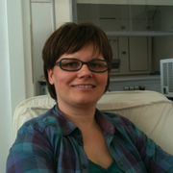
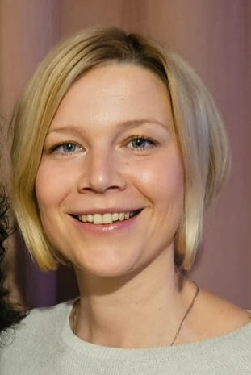

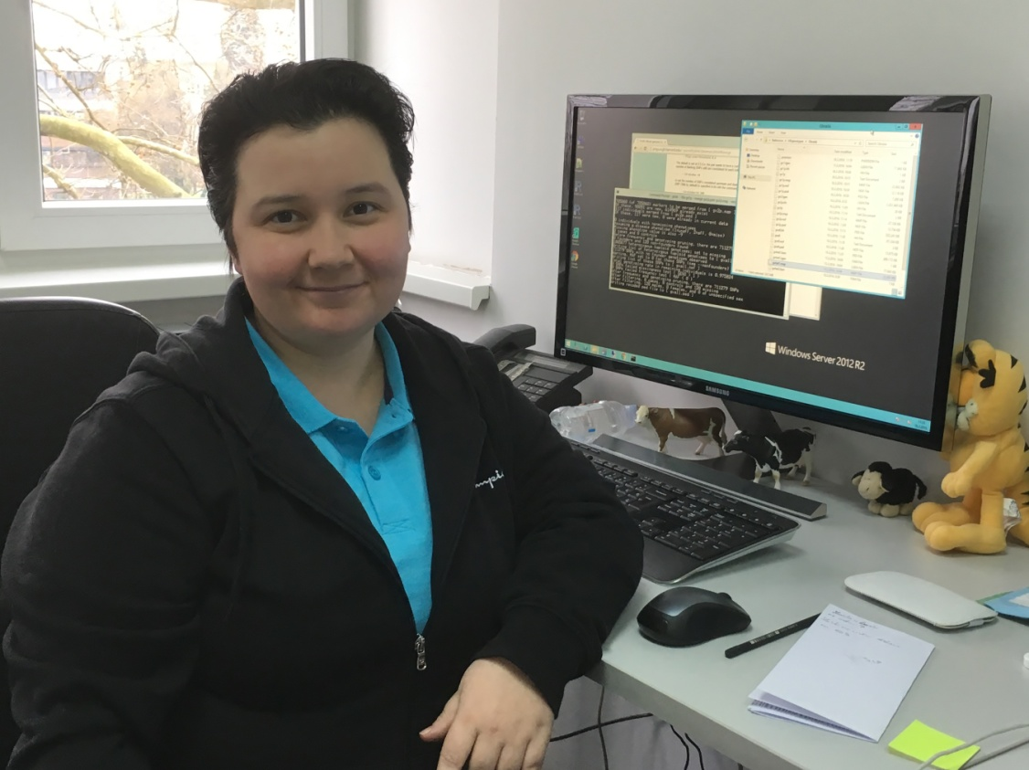


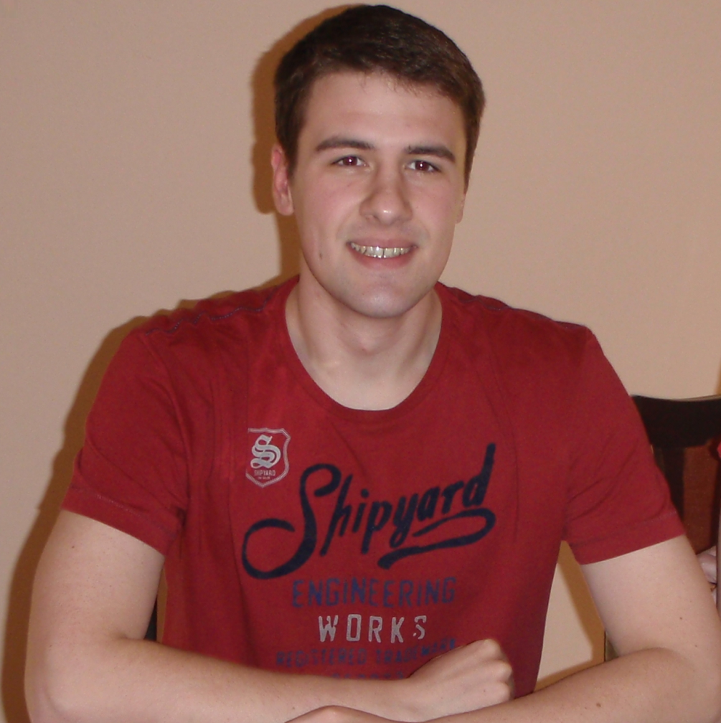
Animal Genetics Group
https://angen.agr.hr
Department of Animal Science
Ino Čurik
Full Prof.
Maja Ferenčaković
Assoc. Prof.
Vlatka Čubrić Čurik
Prof.
Ivana Držaić
PhD
Senior Expert Associate
Mario Shihabi
PhD
Vladimir Brajković
Asst. Prof.
Ivana Keršić
PhD student
Zvonimir Mijadžiković
PhD student

Slide 3
Department of Animal Science
Undergraduate Study (BS) – Animal Science
Animal genetics
Biometrics
Basics of domestic animal breeding
Structure of animal genome
Doctoral Study – Agricultural Sciences
Archaeogenetics
Genomic data analysis
Population and quantitative genetics in animals
Graduate Study (MS) – Animal Breeding and Genetics
Animal Breeding
Biometrics and animal research planning
Conservation genetics
Genome Analysis Using Bioinformatics Tools
Molecular genetics of animals
Population genetics
Quantitative genetics
Variability of Y chromosome and mtDNA
Specialist Study – Animal Sciences
Animal breeding and selection plans
Basics of genetics in animal husbandry
Laboratory for conservation genetics
Archaeogenetic laboratory
Bioinformatics approaches in animal breeding
Summer
School

Slide 4
On going projects leaded by our group:
2023-2027, PhenoGeno “Responding to innovations in phenomics and genomics in dairy cattle breeding“ HRZZ, IP-2022-10-6914, project manager Prof. Ino Čurik, PhD.H
2023-2027, Gabridge “Bridging the Disciplinary Gap: Integrating Animal Genetics and Archaeology in Croatia“ HRZZ IP-2022-10-8926, project manager Prof. Vlatka Čubrić Čurik
Bioinformatics approaches in animal breeding
Summer
School

Slide 5
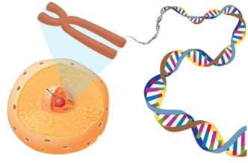
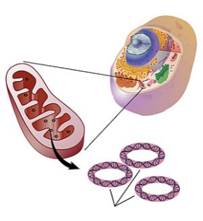
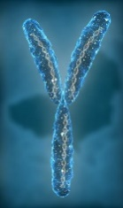



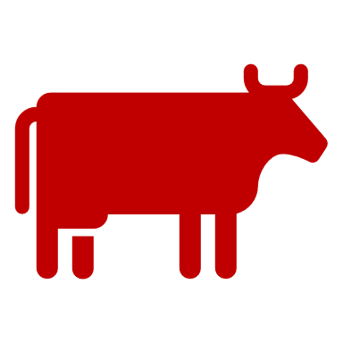
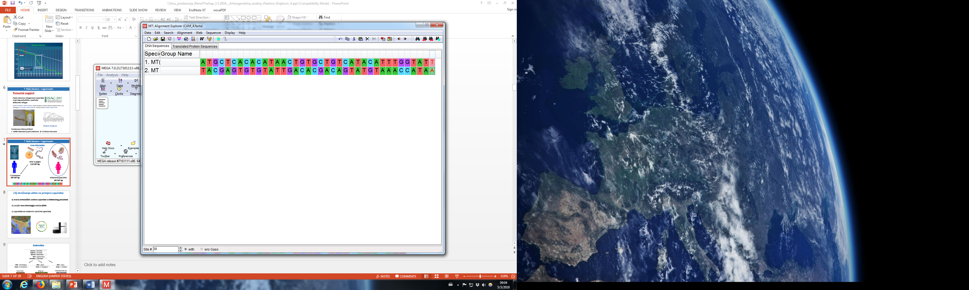
Nuclear DNA
nDNA
3×10⁹ bp
or 3,000,000,000 bp
Nuclear DNA
Y chromosome
46 chromosomes - human
60 chromosomes - cattle
Mitochondrial DNA
mtDNA or mitogenome
59×10⁶ bp
or 59,000,000 bp
16×10³ bp
or 16,000 bp
Double stranded DNA – length in base pair (bp)

Slide 6
“Utilisation of the whole mitogenome in cattle breeding and conservation genetics“, MitoTAUROmics, 2014 – 2018, HRZZ IP-11-2013-9070
Case studies:
Impact on the milk production
Pedigree verification & imputation – MaGelLAn 1.0 → 2.0 → 2.1
Diversity & Domestication
Identification of detrimental mutations
Selection, validation, and utilization of mitogenome SNP array

Slide 7
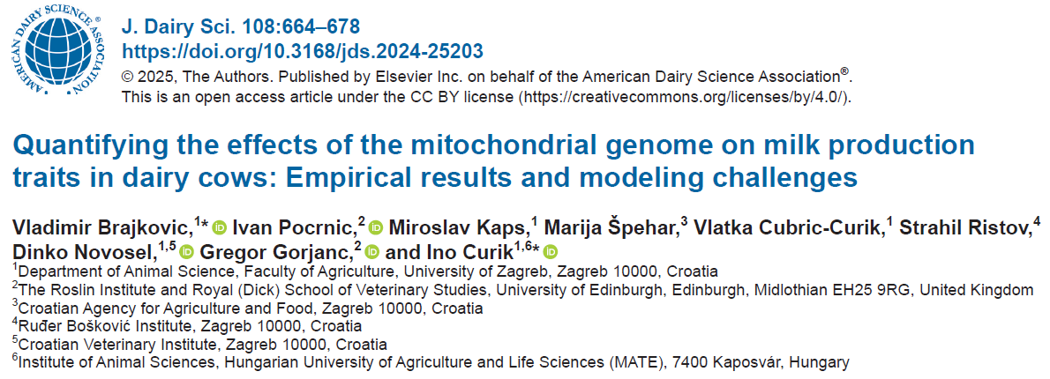
https://www.sciencedirect.com/science/article/pii/S0022030224012219

Slide 8
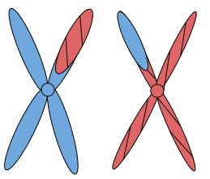
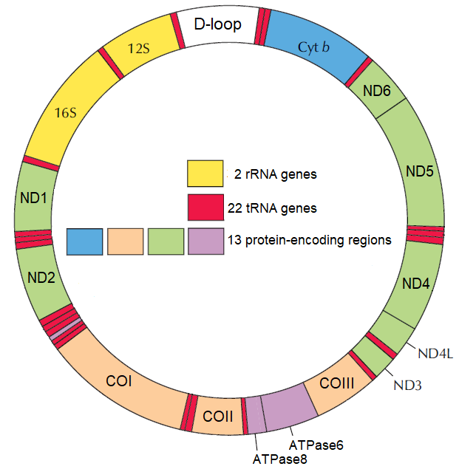

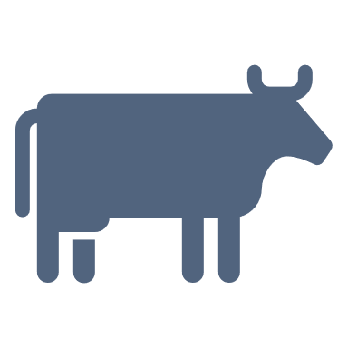
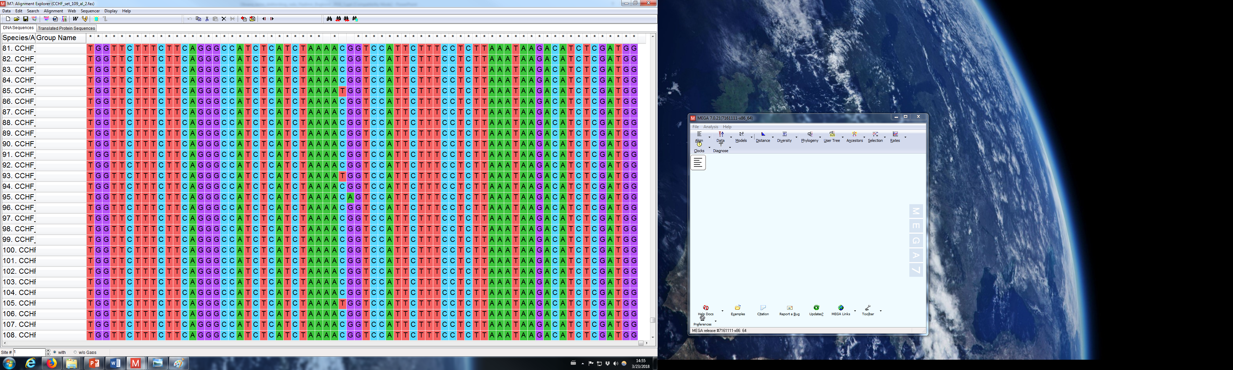
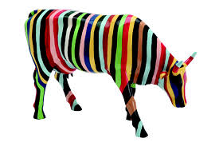
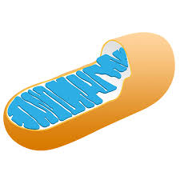
Background
High mutation rate
(mtDNA 10-1000x > nDNA)
Genotype + Environment = Phenotype
Mitogenome
maternal transmission ♀ → maternal lineage = mitogenome
coding of 37 genes (13 of ~ 85 OXPHOS components → cell energy ⚡)
small circular molecule (mtDNA≈16.472 bp : nDNA≈3*10⁹ bp)

Slide 9
Mitogenome impact on the phenotypic variability
Analyses with maternal lineage and D-loop mtDNA :
→ 0 to 4-5% phenotypic variability
Bell et al., 1985; maternal lineage
Kennedy 1986; maternal lineage
Schutz et al., 1994; mtDNA D-loop
Boettcher et al., 1996; mtDNA D-loop, rRNA
Boettcher and Gibson 1997; maternal lineage
Roughsedge et al., 1999; maternal lineage
Špehar et al., 2017; maternal lineage
milk production traits in cattle

Slide 10
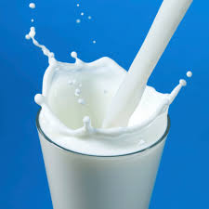
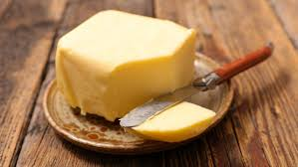
Aim of this research
→ estimation of mitogenome contribution to the total variance for milk traits
in first five lactations:
milk yield – MY
fat yield – FY
protein yield – PY

Slide 11
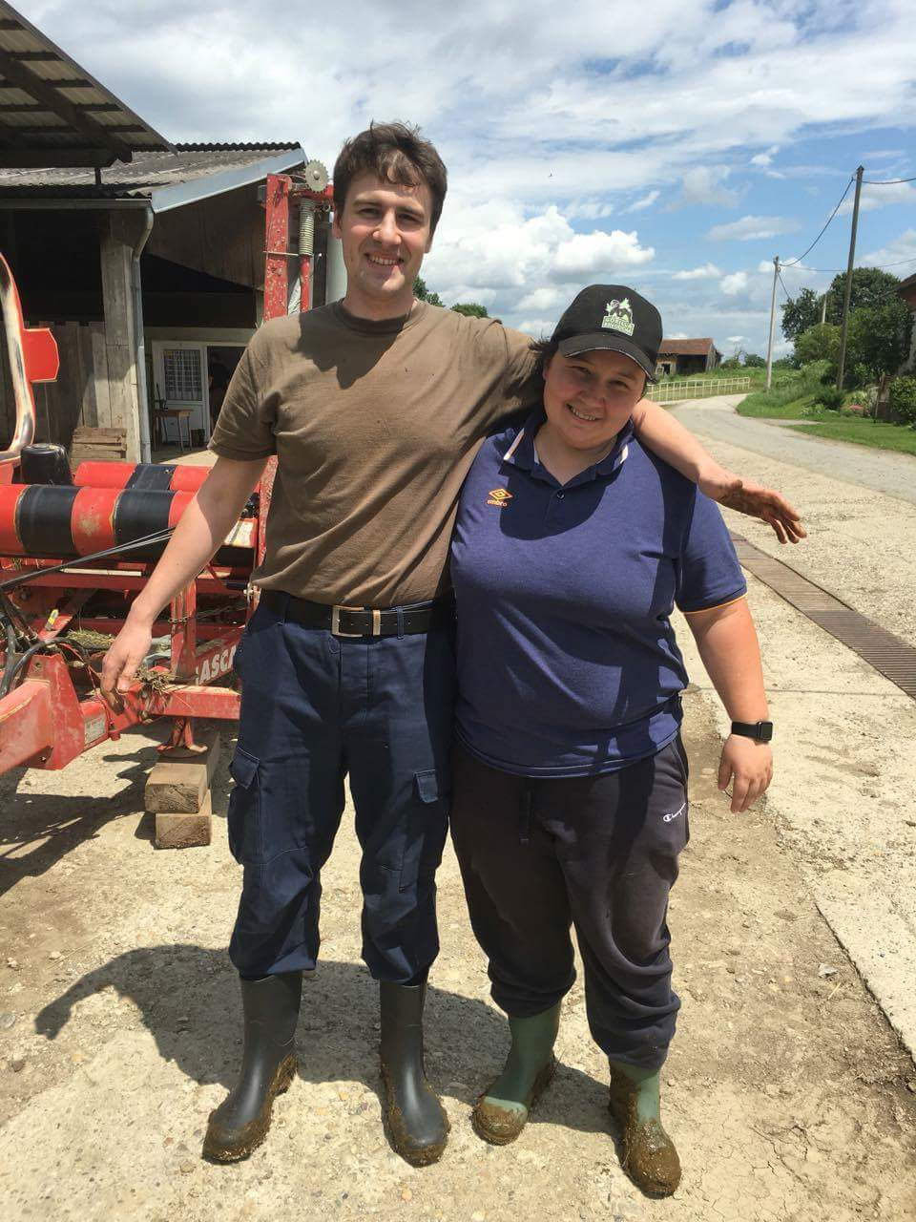
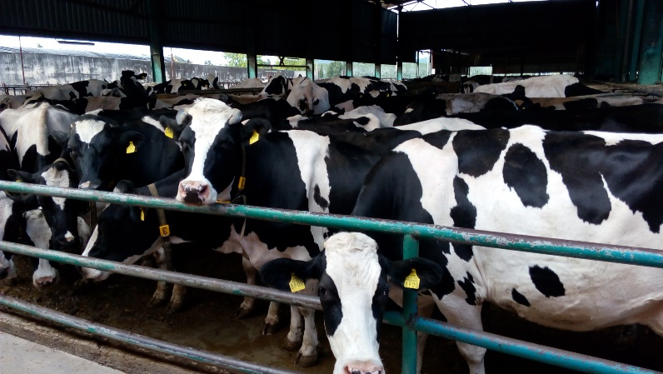
Material - sampling
pedigree of Holstein cows ← HPA
↓
295 349 individuals – phenotypic information
↓
20 973 lactating individuals in 2016.
↓
individuals born 2010. – 2013.
↓
mitogenome sequencing
Stat | N
Samples | 109
- milk | 86
- tissue | 1
- hair | 22

Slide 12
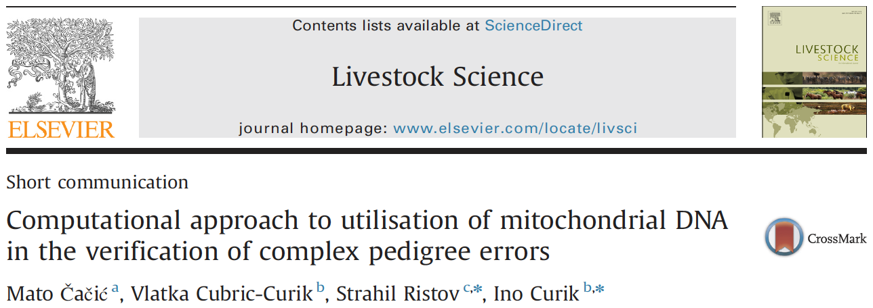
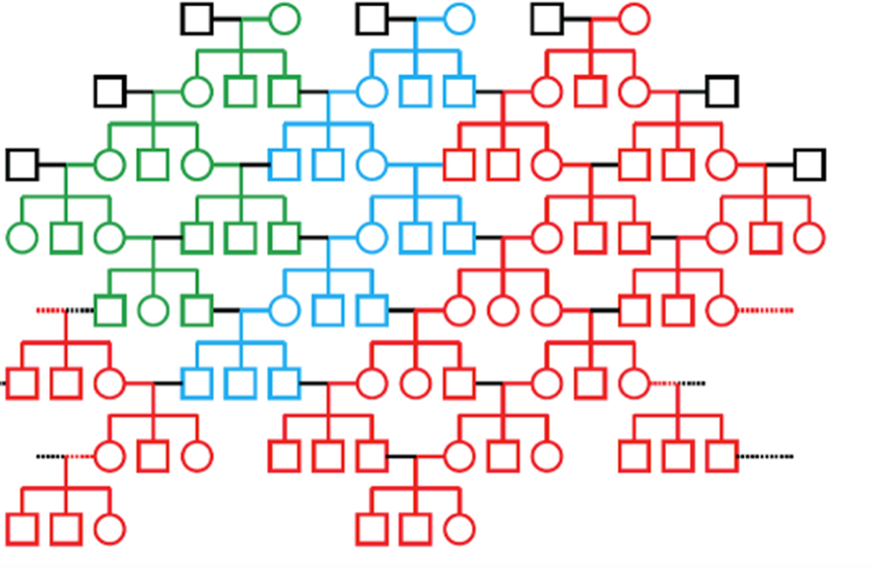
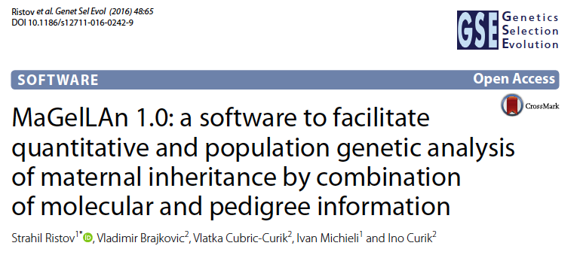
Pedigree analysis and imputation
ML1
ML2
ML3
Maternal lineages
↓
founders = 109
individuals = 2373
Pedigree
individuals = 109
”Maternal inheritance without recombination”
“Molecular pedigree”
MaGelLAn (Maternal Genealogy Lineage Analyser)
mag_verif.py
mag_stat.py
mag_sampl.py
mag_calc.py
Imputation

Slide 13
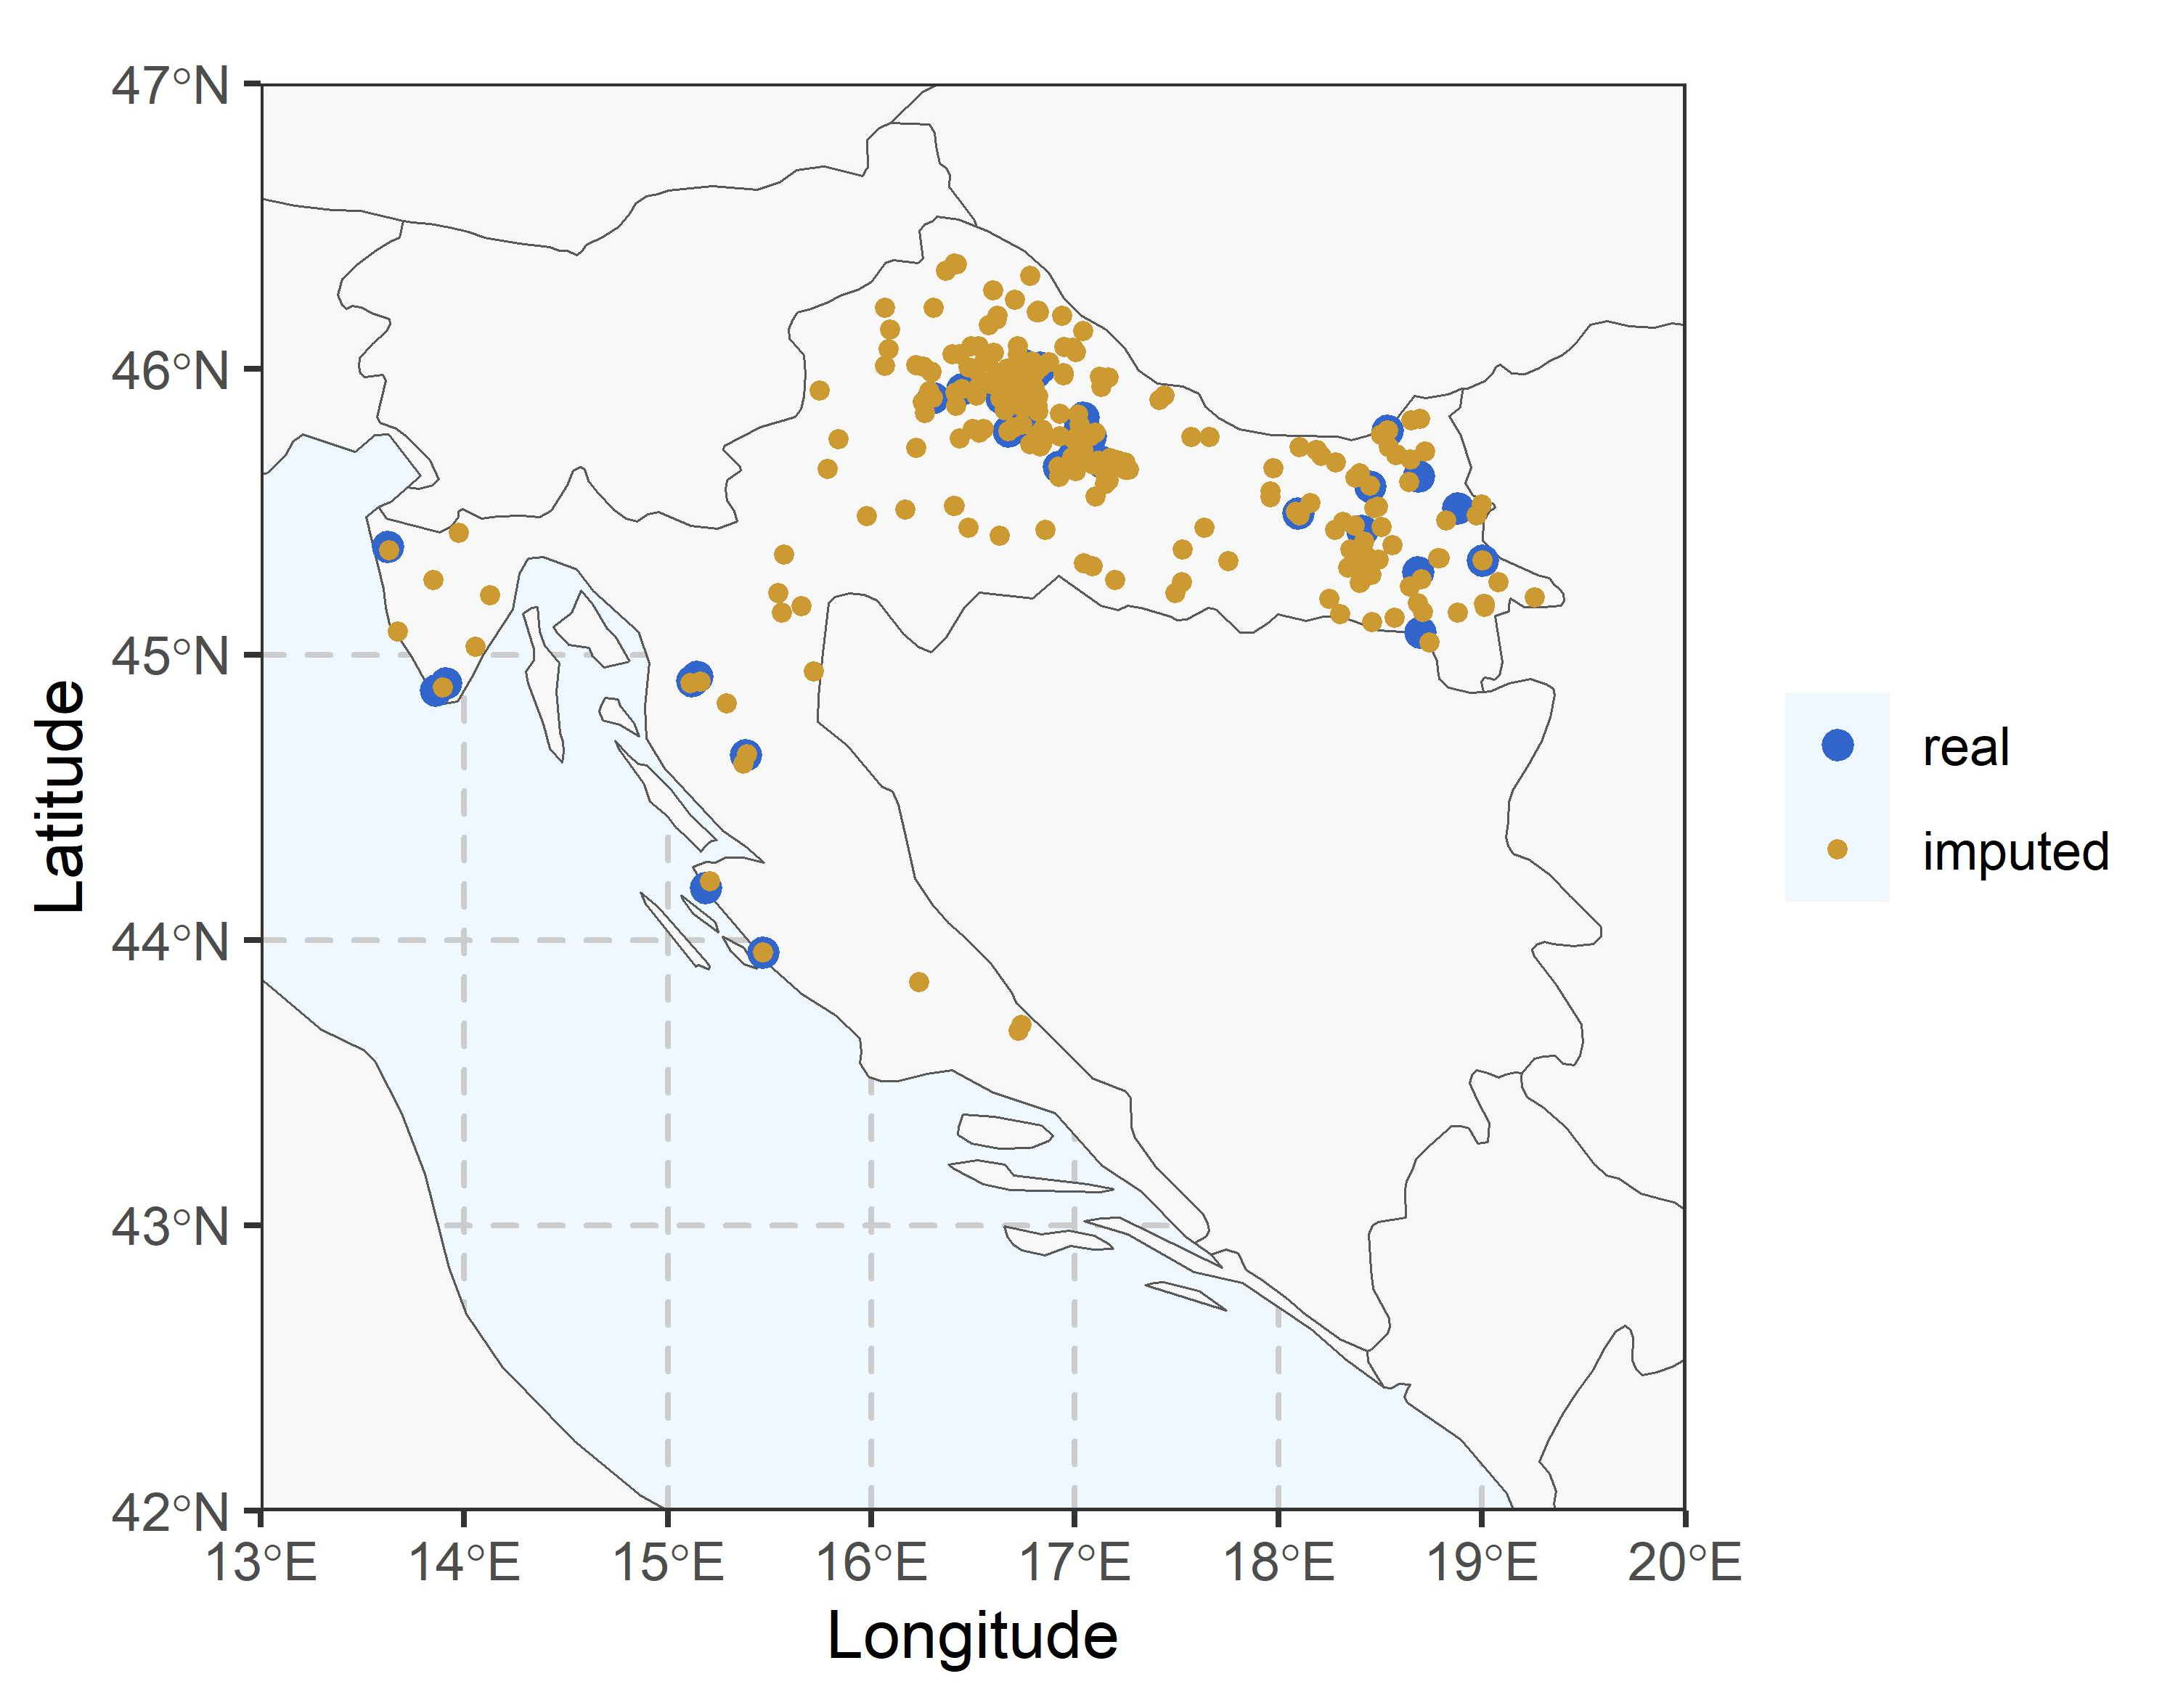
Material - sampling
Stat. | N
Samples | 109
Regions | 7
Farms | 40
→
→
→
N
3040
16
202

Slide 14
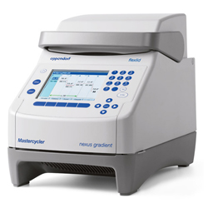
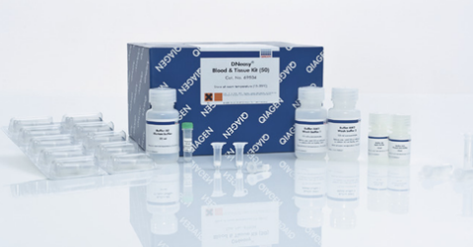
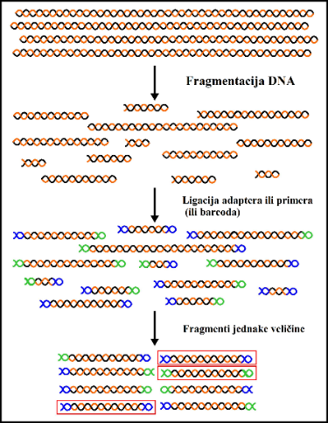
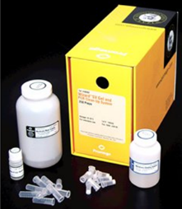
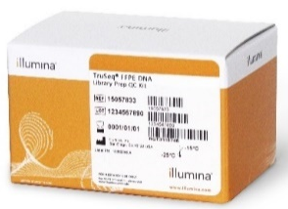
Methods
DNA extraction
↓
3 step PCR for mitogenome amplification
↓
purification of PCR products
↓
NGS library preparation
↓
sequencing service
Illumina HiSeq 1500
↓
Raw sequences .fastq.qz format

Slide 15

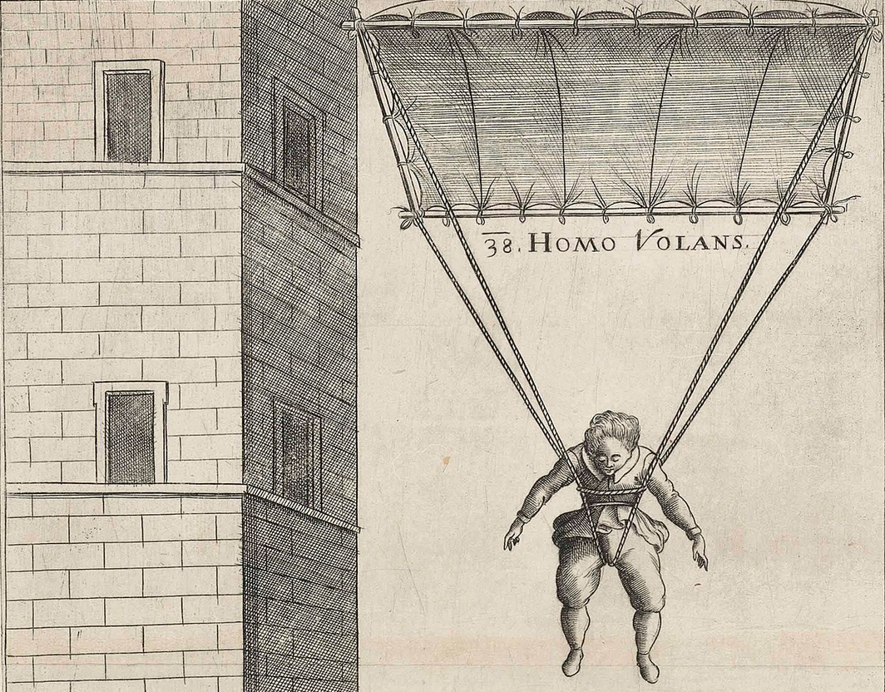


Methods
FastQC
QC raw reads - fastq.qz
Sequencing service
Trim
Trimming
FastQC
QC after trimming
BWA
Read “alignment”/mapping
& adding header
Alignmet post procesing:
File conversion & sorting
Removal of PCR duplicates
Quality reads filtering
Samtools
+
VDC „Štampar“ data storage
+
VCF
Variant calling
Padobran
Supek
HDD space required:
GATK,
BCF&Bedtools
Variant post processing:
Consensus sequence - fasta
Mitogenome from lWGS 1x
High Performance Computing HPC
ANGSD
~ 9 GB
Consensus sequence from .bam file
Mitogenome from WGS 30x
Samtools
Depth and breath of coverage
~ 200 - 300 GB

Slide 16


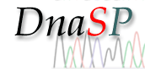


Methods
↓
.fasta
↓
↔
↔
↔
↓
↓
CYTO maternal pedigree lineages - 109
HAPLO sequence haplotypes - 96
AMINO aminoacid haplotypes - 48
EVOL phylogenetic haplogroups - 10
SNPmt mutations - 359

Slide 17
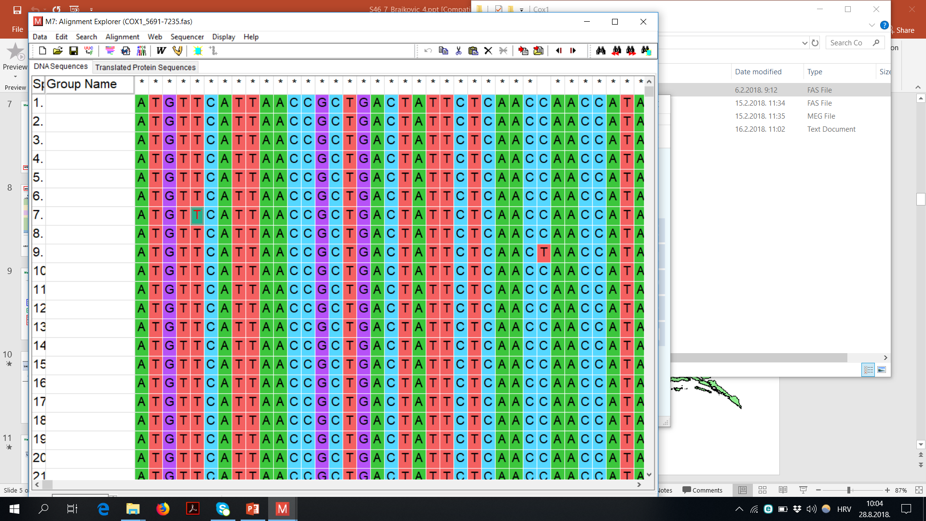

Methods
AMINO aminoacid haplotypes
HAPLO sequence haplotypes
Mitogenome region | V | Length bp | Position bp
ND1 | 7 | 957 | 3104-4060
ND2 | 5 | 1044 | 4269-5312
COX1 | 2 | 1545 | 5691-7235
COX2 | 1 | 684 | 7380-8063
ATP8 | 2 | 201 | 8135-8335
ATP6 | 4 | 681 | 8296-8976
COX3 | 7 | 804 | 8976-9779
ND3 | 2 | 357 | 9829-10185
ND4L | 1 | 297 | 10245-10541
ND4 | 6 | 1425 | 10535-11959
ND5 | 11 | 1821 | 12115-13935
ND6 | 1 | 528 | 13919-14446
CYTB | 10 | 1140 | 14520-15659
 | 59 | 11484
Mitogenome
16345 bp
↓
363 variable sites
↓
96 haplotpyes
↓
↓
↓
48 aminoacid haplotpyes

Slide 18
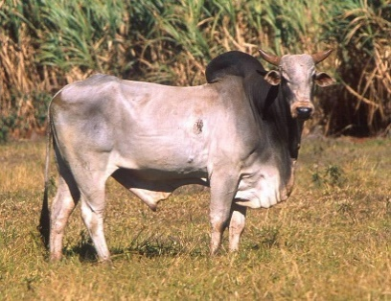
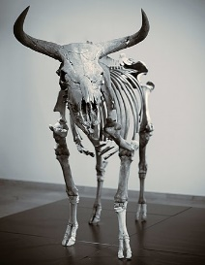
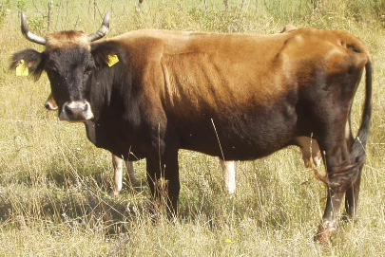
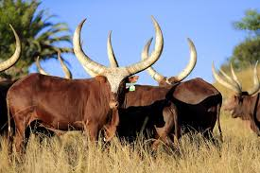
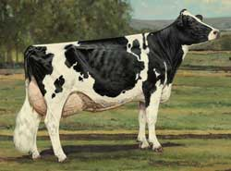
Methods
EVOL phylogenetic haplogroups
Zebu from South Asia
Auroch
10 evolutionary haplogroups
↓
T2 = 1; T3 =8 i T5=1
↓
BEAST - Bayesian phylogenetic analysis
↓
802 mitogenomes, 114 cattle breeds
↓
Cubric-Curik i sur., 2021
Buša from Croatia
Ankole from Uganda
https://onlinelibrary.wiley.com/doi/full/10.1111/eva.13315
Holstein from USA

Slide 19

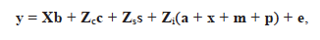
Methods – statistical model
mitogenome impact on the phenotypic variability
Bayesian numerical procedure - integrated nested Laplace approximations (INLA)
linear mixed model – animal model – repeatability model :
- INLA
Zenodo & GitHub
Milk yield; (y)
Fat yield; (y)
Protein yield; (y)
dependent variable → first five lactation – repeatability model
Interaction between Number of calving & Age at calving (X)
covariate
Herd-year-season effects (Z_{C})
random effect
Herd location effects (Z_{S})
Additive genetic effect of autosomal DNA with pedigree-relationship matrix A (a)
Additive genetic effect of X chromosome DNA with pedigree-relationship matrix (x)
Cytoplasmatic/maternal effects – (m) → CYTO, HAPLO, AMINO, EVOL, SNPmt
Permanent environmental effect – (p)
random effect
Residual effect (e)
random effect

Slide 20
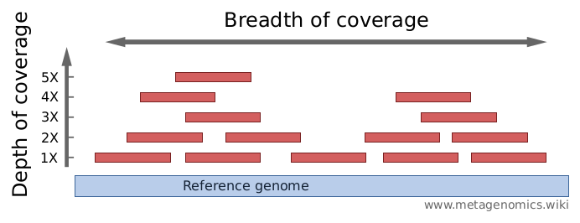
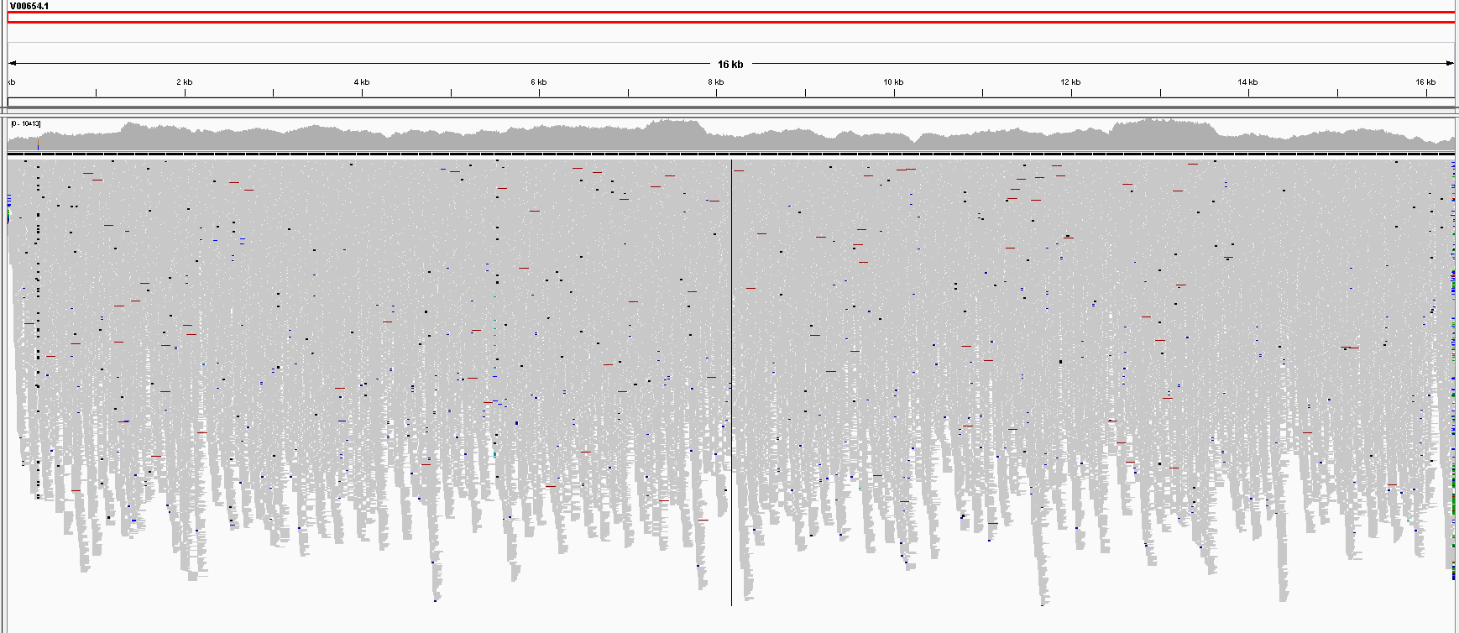
Results – mitogenome coverage
16338 bp
100%
holstein
6.170,13
IGV - Integrative Genomics Viewer
Bayesian numerical procedure - integrated nested Laplace approximations (INLA)
Linear mix model - Animal model
Modelling the Impact of Mitochondrial Genome on Quantitative Traits: case study in dairy cattle production

Slide 21
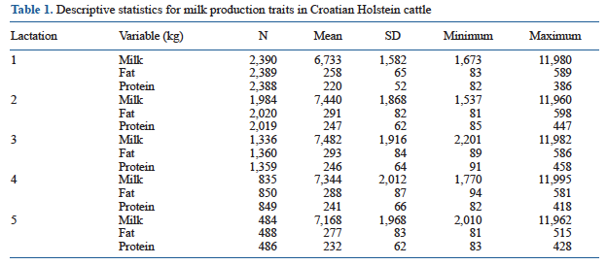
Mitogenome impact on the milk production
Bayesian numerical procedure - integrated nested Laplace approximations (INLA)
Linear mix model - Animal model
Modelling the Impact of Mitochondrial Genome on Quantitative Traits: case study in dairy cattle production

Slide 22
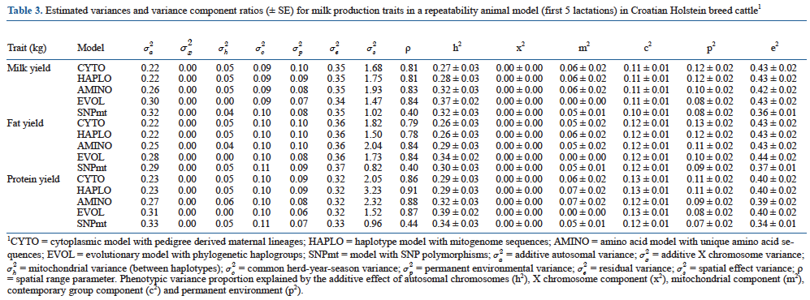
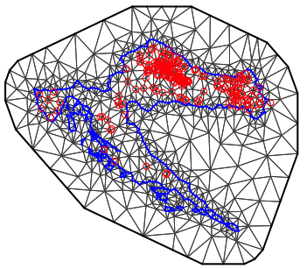
Mitogenome impact on the milk production
Bayesian numerical procedure - integrated nested Laplace approximations (INLA)
Linear mix model - Animal model
R-INLA mesh of individuals belonging to 109 maternal lineages
Modelling the Impact of Mitochondrial Genome on Quantitative Traits: case study in dairy cattle production

Slide 23
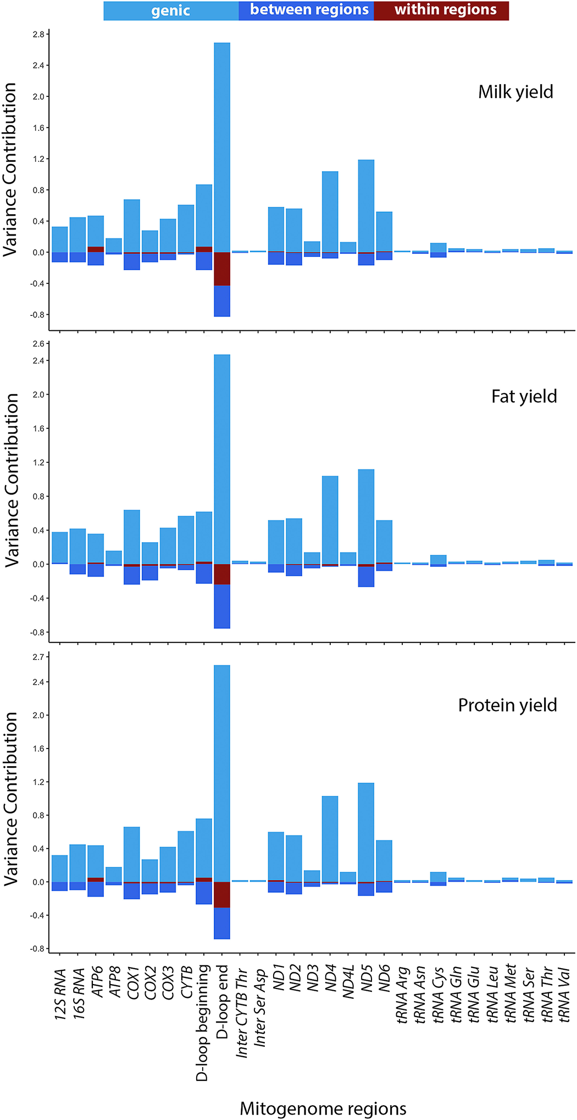
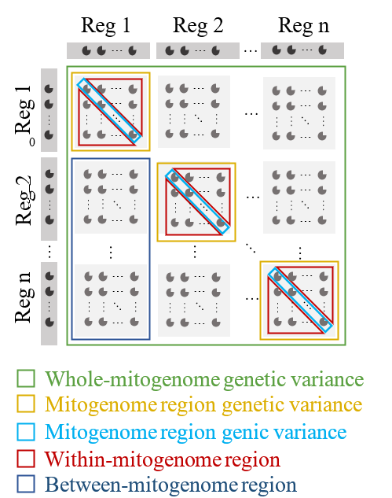
Decomposition of Mitogenome Variance to Gene Regions
SNPmt model
variances and covariances between and within defined mitogenome regions estimated for milk production traits
similar decomposition
the largest contribution to variance was observed for the D-loop end, ND5 and ND4
covariances were larger between SNPs located in different mitogenome regions
the only substantial (negative) covariance within mitogenome regions was estimated between SNPs located in the D-loop end

Slide 24
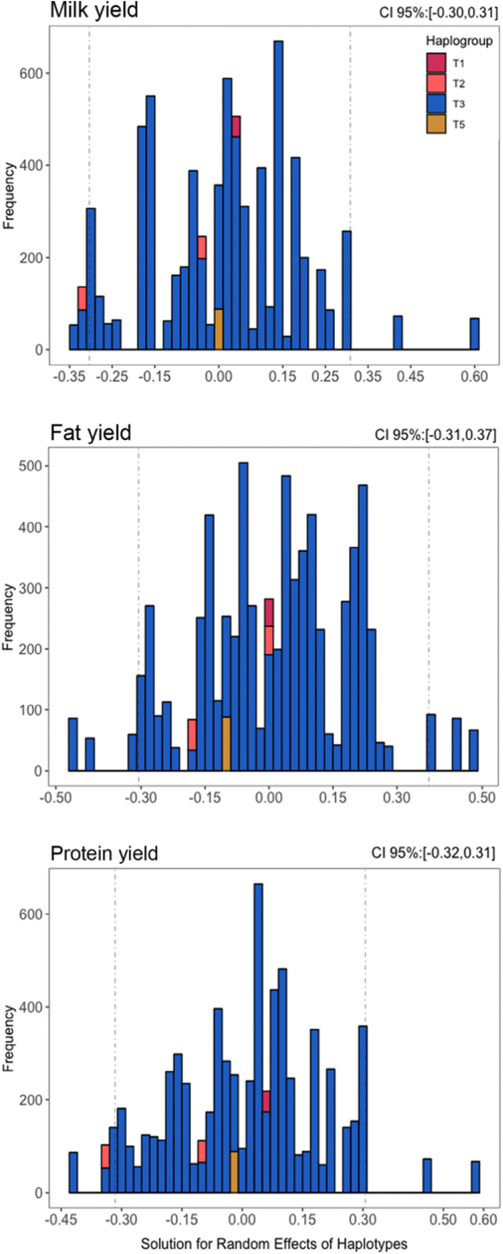
Distributions of haplotype effects in phenotypic SD
The range of estimated haplotype effects was approximately between −0.5 and 0.5 phenotypic standard deviations, which is a large effect.
Bayesian numerical procedure - integrated nested Laplace approximations (INLA)
Linear mix model - Animal model
Modelling the Impact of Mitochondrial Genome on Quantitative Traits: case study in dairy cattle production

Slide 25
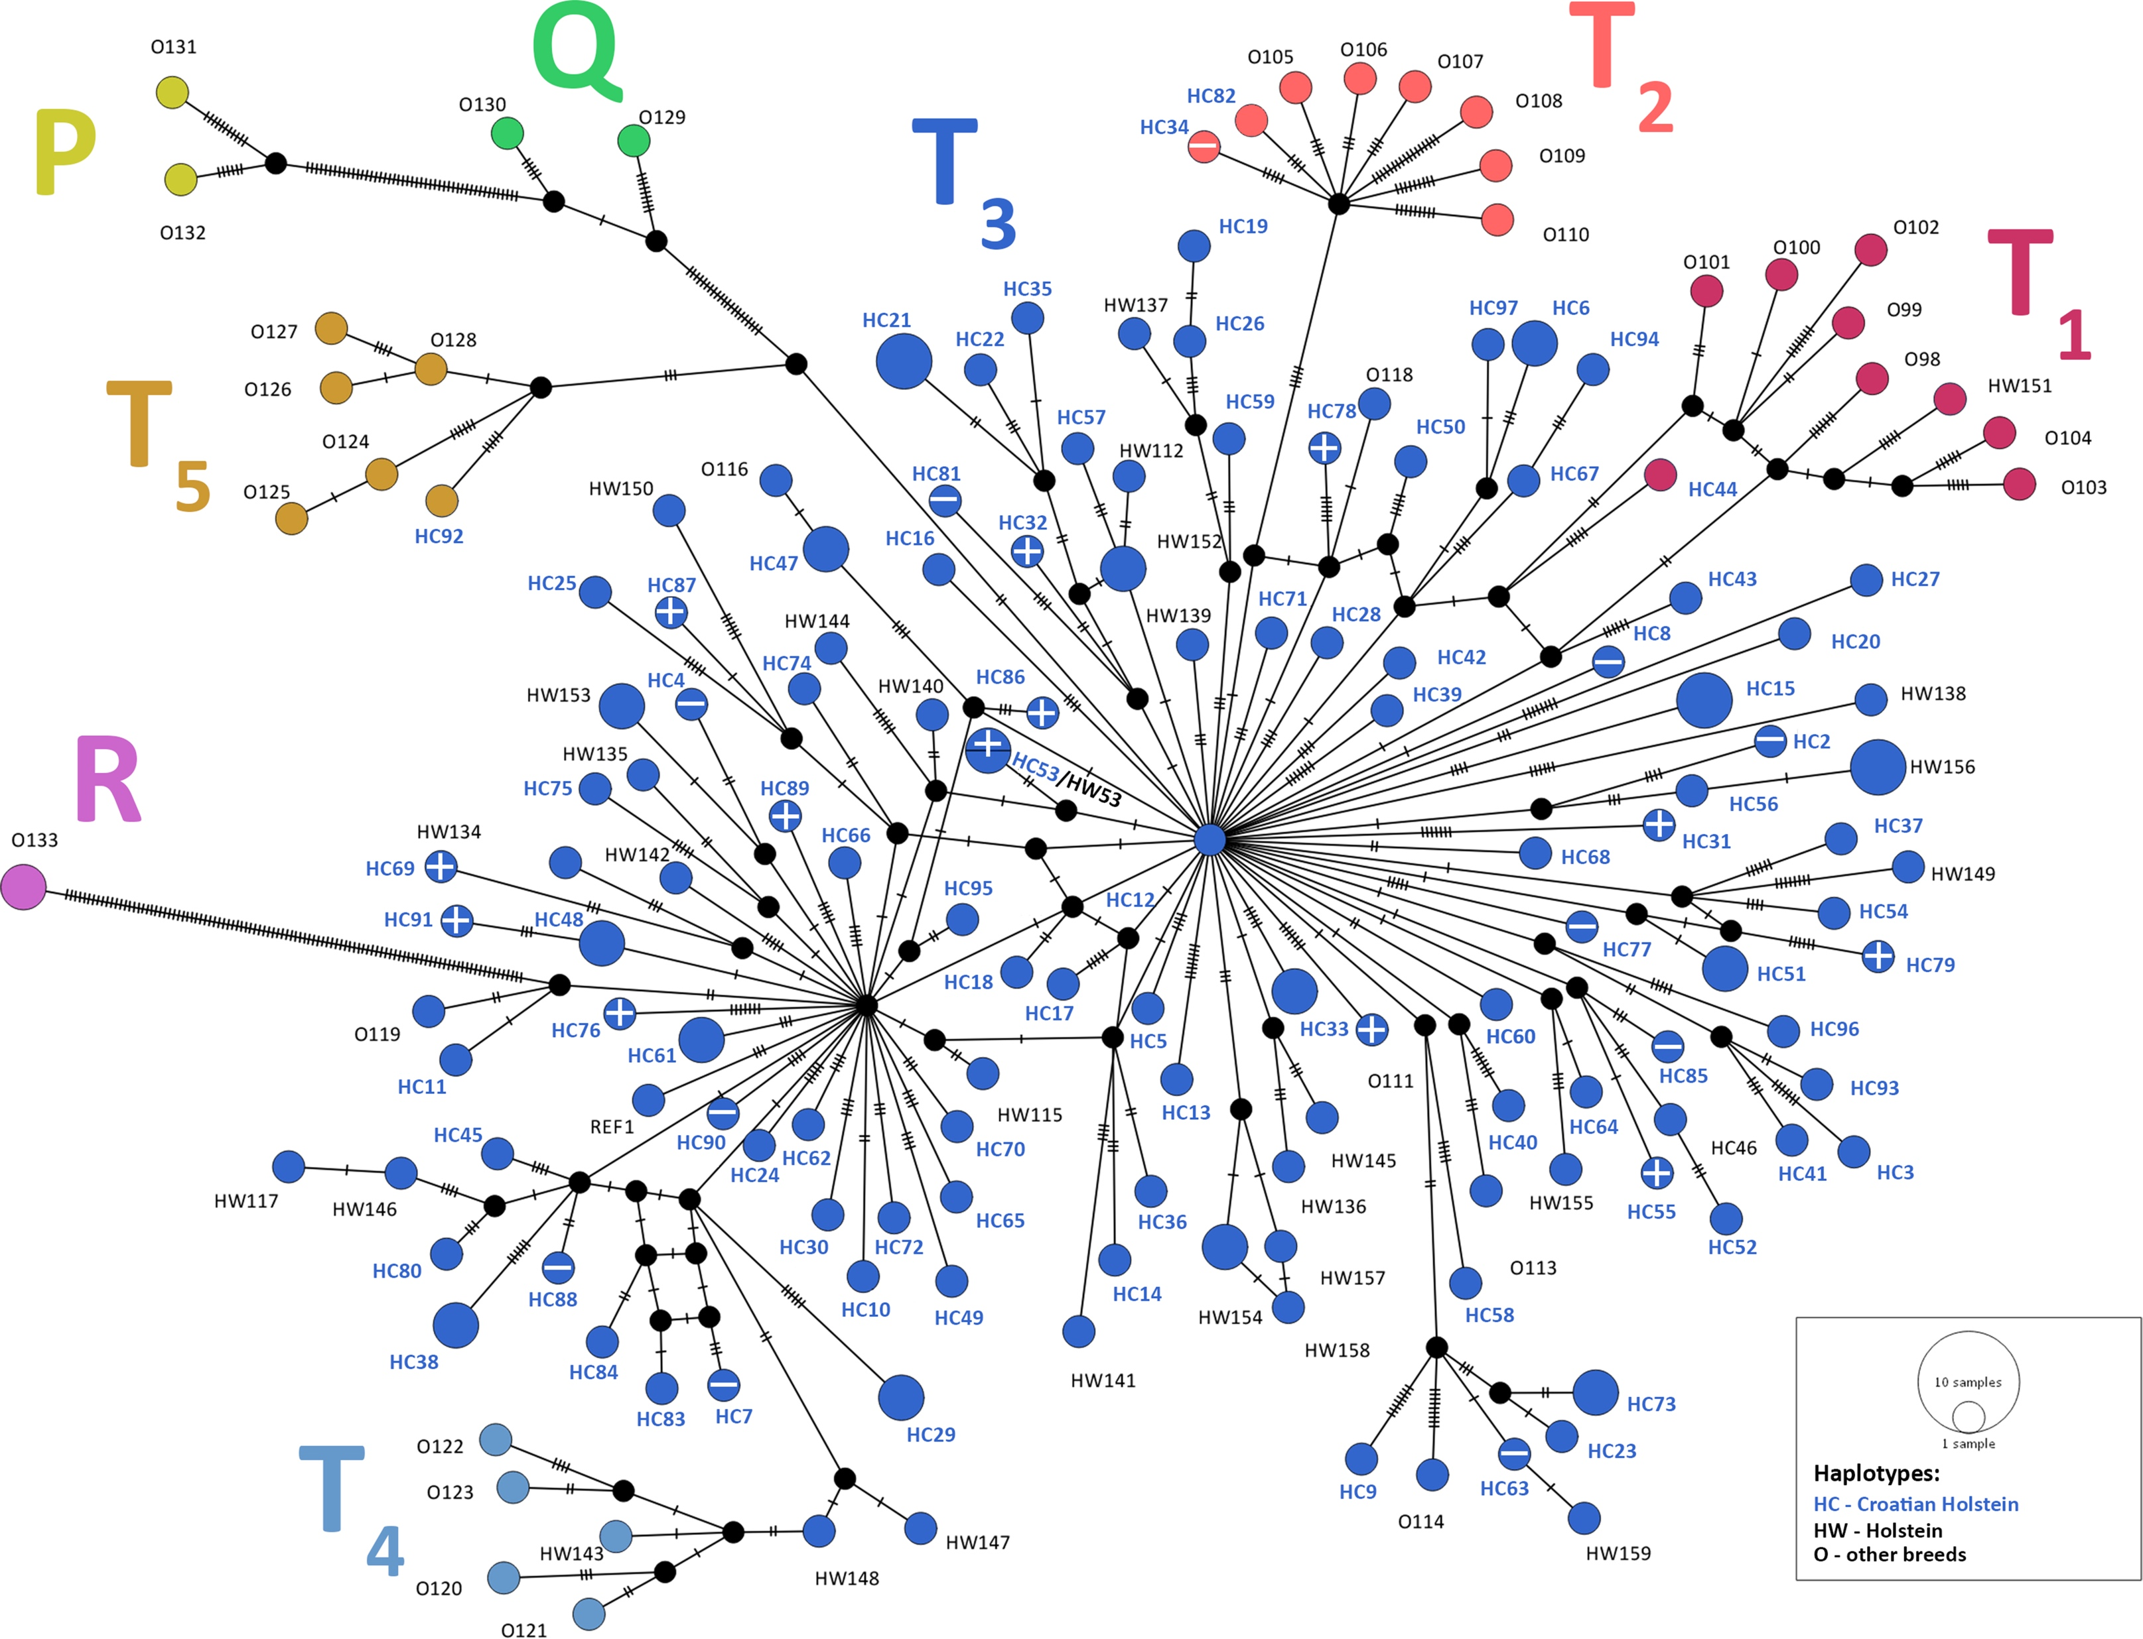
Median-joining network
+ indicates the 10% of the best haplotypes with the largest random solution effects
- indicates the 10% of the worst haplotypes with the smallest random solution effects
for milk, fat, and protein

Slide 26
Conclusion
Significant contribution of mitogenome on milk production traits in Holstein cows in Croatia:
milk yield
fat yield
protein yield
5 - 7 % of phenotypic variabilitiy
Integrating complete mitogenome data offers additional insights, allowing identification of haplotypes or SNPs contributing to differences
These results require validation in other cattle populations with more sequenced genomes/mitogenomes and phenotyped animals
The potential for using mitogenome data in animal breeding is promising

Slide 27
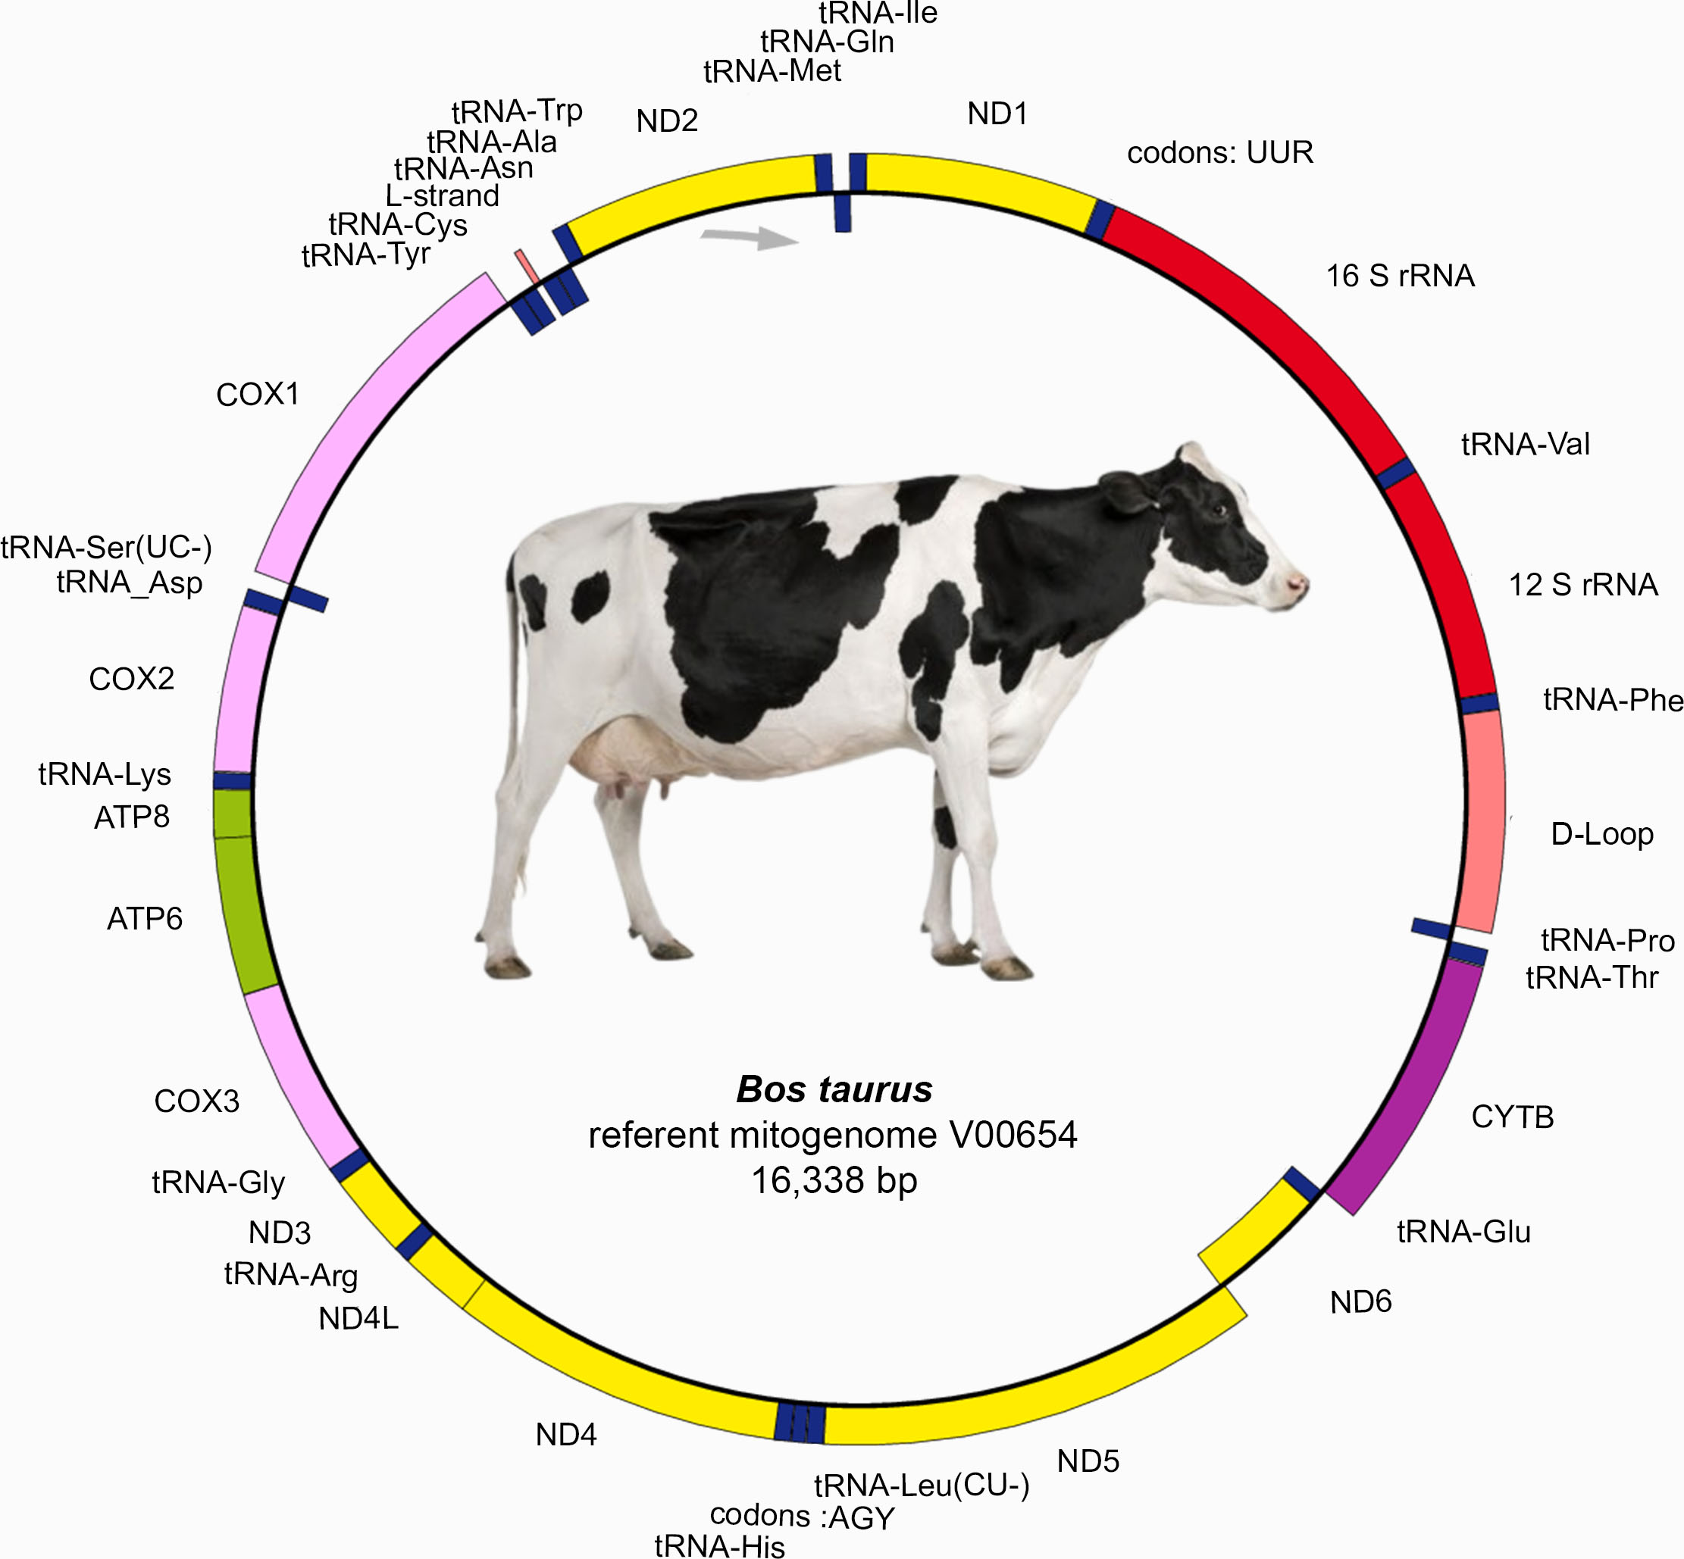
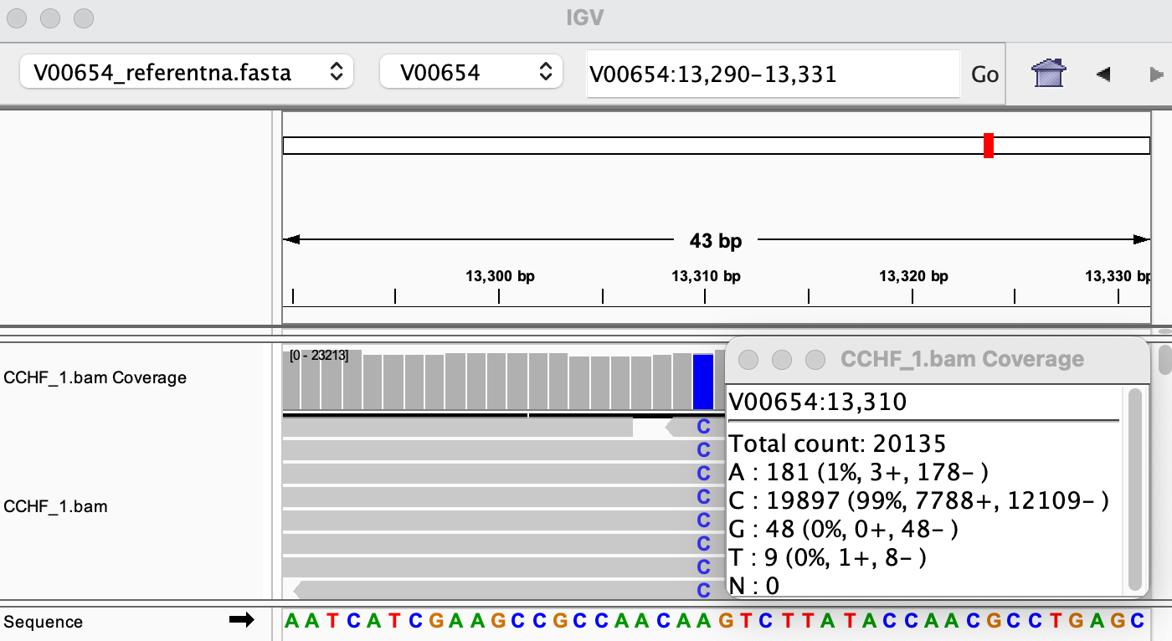

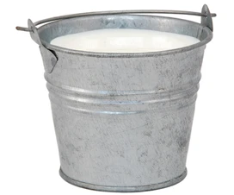



Quantifying the effects of the mitochondrial genome on milk production traits in dairy cows: Empirical results and modeling challenges
CTT | CCC | TCT | GCA | TCA | AGC | ACA | ATA | GTG | ATA
CTT | CCC | TCT | GCA | TCA | AGC | ACA | ATG | GTG | GTG
CTT | CCC | TTT | GCA | TCA | AGC | ACA | ATA | GTG | GTG
CTT | CCC | TCT | GCA | TCA | AGC | ACA | ATA | GTG | GTG
HAPLO model
Leu | Pro | Ser | Ala | Ser | Ser | Thr | Ile | Val | Ile
Leu | Pro | Ser | Ala | Ser | Ser | Thr | Met | Val | Val
Leu | Pro | Phe | Ala | Ser | Ser | Thr | Ile | Val | Val
Leu | Pro | Ser | Ala | Ser | Ser | Thr | Ile | Val | Val
Mitogenome
NGS
AMINO model
e², 0.43
e², 0.42
p², 0.12
p², 0.10
c², 0.11
c², 0.11
m², 0.06
m², 0.06
h², 0.28
h², 0.32
$$m_{haplo}^{2}=\frac{σ_{haplo}^{2}}{σ_{p}^{2}}$$
$$m_{amino}^{2}=\frac{σ_{amino}^{2}}{σ_{p}^{2}}$$
Maternal lineage imputation
Phenotypic variance explained for milk yield
Haplotype effects
(kg milk in $σ_{p}$)
https://angen.agr.hr/hr/group/76/MaGelLAn+2.0

Slide 28

https://www.sciencedirect.com/science/article/pii/S0022030224012219

Slide 29

Sequencing → genotyping technology
Sequences
Genotypes (SNP chip 50K or 100K or 777K)
↓
3,000,000,000 bp
50,000 or 100,000 or 777,777 SNPs
↓
- NGS-
Next generation sequencing
Massively parallel sequencing
“cheaper, more routinely used in livestock selection”

Slide 30

The aim of this study
To increase the use of mitogenome information in animal breeding and genetics:
NGS mitogenome sequence study → GGP mitogenome SNPs study
To select and verify of 331 mitochondrial SNPs for the new NEOGEN GGP Bovine 100K SNP Chip
To develop a pipeline for practical analysis
New version of MaGelLAn v2.0 software

Slide 31

Background
"Utilisation of the whole mitogenome in cattle breeding and conservation genetics“
MitoTAUROmics 1.7.2014. – 31.10.2018
Diversity & Domestication
Pedigree verification & imputation – Magellan 1.0
Impact on the milk production
Identification of detrimental mutations
Presence of selection

Slide 32

Background
1068 (741) mitogenome sequences, > 150 (92) breeds
since publication, already includes a newly expanded set of 1068 sequences and over 150 breeds
newly expanded set of 1068 mitogenome sequences and over 150 breeds

Slide 33

SNP preselection material and methods
mitogenome SNPs - pairwise SNP F_{ST} = 1
Bonfiglio et al. 2012 PLoS ONE

Slide 34
SNP selection n=331
SNP selection included 331 SNPs:
i) 289 SNPs for haplogroup classification (T₁, T₂, T₃, T₄, T₅, P, Q, R, I)
ii) 10 SNPs for LHON¹ disease
iii) 32 SNPs for MELAS² disease
More detailed haplogroup classification within the T3 haplogroup
Quantitative trait variation
¹Leber Hereditary Optic Neuropathy
²Mitochondrial Encephalopathy, Lactic Acidosis, and Stroke-like episodes

Slide 35

SNP selection n= 331 → 317 → 310

Slide 36
Workflow
1. GGP Bovine 100K SNP Array
- R Tidyverse
2. Import data
- R Tidyverse
3. Merging with referent mitogenome database and formatting
(.txt .csv .ped .map .fasta)
- Magellan 1.0
- Magellan 1.0
4. Haplogroup classification
5. Pedigree verification
6. Imputation - quantitative studies
7. Deleterious mutation detection
8. Mitogenome and nuclear diversity
- PopART
4.1. MJ network
6.1. Pedigree
- R Tidyverse
6.2. Haplotype
4.2. Specific SNP classification
- MitoToolPy, BEAST ….
Magellan v2.0 !!!
9. Standard mitogenome classification and phylogenetics

Slide 37

3. Merging with the referent mitogenome database
Checking SNP consistency
NGS SNP string (.fasta)
GGP SNP string (.fasta)
A
A
G
A
C
T
NGS Sequences
NEOGEN GGP Bovine 100K SNP Chip
NGS Sequences vs GGP – checking SNP consistency

Slide 38

4. Haplogroup classification - validation
Samples: SEQ – GGP
129 – 129
Additional GGP:
135
+
GenBank SEQ:
119
∑383
Median-joining network
181 SNPs
77 haplotypes

Slide 39
5.-6. Pedigree analysis and imputation
ML1
ML2
ML3
Maternal lineages
↓
founders = 109
individuals = 2373
Pedigree
individuals = 109
”Maternal inheritance without recombination”
“Molecular pedigree”
MaGelLAn (Maternal Genealogy Lineage Analyser)
mag_verif.py
mag_stat.py
mag_sampl.py
mag_calc.py
Imputation

Slide 40
6.1-2. Mitogenome impact on the milk production
Bayesian numerical procedure - integrated nested Laplace approximations (INLA)
Linear mix model - Animal model

Slide 41



7. Deleterious mutation detection
Exophthalmos
Histopathological examination and
IHC detection of caspase-3 – apoptosis
and oedema in the eye bulb and brain
Homoplasmic mutation
Multifasta file
Gavtraža
https://pubmed.ncbi.nlm.nih.gov/35683014/
First detrimental mitogenome mutation in cattle
Model for better understanding of the pathogenesis of LHON
Maternal lineage analysis

Slide 42









8. Mitogenome and nuclear diversity
F_{ST} values: mitogenome SNPs (317) vs autosomal SNPs (70242)
 | (10) |  | (12) |  | (13) |  | (10) |  | (24) |  | (25) |  | (24) |  | (30) |  | (85)
 | Katerini O. |  | Short. Pin. |  | Short. Rod. |  | Katerini T. |  | Sla.Syr.Pod. |  | Busa |  | Murbodner |  | Boskarin |  | Holstein
Short. Pin. | 0.04 | 0.05
Short. Rod. | 0.00 | 0.09 | 0.03 | 0.11
Katerini T. | 0.31 | 0.16 | 0.35 | 0.18 | 0.34 | 0.22
Sla.Syr.Pod. | 0.08 | 0.11 | 0.21 | 0.13 | 0.09 | 0.17 | 0.44 | 0.23
Busa | 0.06 | 0.03 | 0.16 | 0.05 | 0.10 | 0.08 | 0.20 | 0.15 | 0.14 | 0.10
Murbodner | 0.05 | 0.07 | 0.07 | 0.09 | 0.06 | 0.12 | 0.19 | 0.19 | 0.14 | 0.13 | 0.13 | 0.05
Boskarin | 0.10 | 0.08 | 0.24 | 0.10 | 0.10 | 0.14 | 0.47 | 0.20 | 0.14 | 0.14 | 0.15 | 0.07 | 0.15 | 0.10
Holstein | 0.07 | 0.09 | 0.21 | 0.11 | 0.10 | 0.14 | 0.45 | 0.20 | 0.11 | 0.15 | 0.14 | 0.08 | 0.24 | 0.10 | 0.09 | 0.13 | -
Genetic differentiation levels
<0.05 | little
0.05 – 0.15 | moderate
0.15 – 0.25 | great
> 0.25 | very great
Hart and Clark 1997

Slide 43


8. Mitogenome and nuclear diversity

Slide 44

8. Mitogenome and nuclear diversity
The fixation index (F_{ST}) is a measure of population differentiation due to genetic structure.
FST is the proportion of the total genetic variance contained in a subpopulation (the S subscript) relative to the total genetic variance (the T subscript). Values can range from 0 to 1. High FST implies a considerable degree of differentiation among populations.

Slide 45



*New version of Magellan 2.0 (2.1) !!!
Dalibor Hršak
Croatia
New version – testing!!!
GUI
Pedigree drawing
Paternal inheritance
Haplogroup classification
Imputation of GGP SNPs
Potential disease identification
Import NEOGEN GGP final report and export:
SNP string (.fasta)
.lgen .fam .map
(.ped, .map; .bim, .bam, .fam)

Slide 46
Conclusion
317(310)/331 mitogenome SNPs have been successfully validated
Contribution as additional information to autosomal markers in Neogene GGP Bovine 100K :
biodiversity
population genomic analyses
cattle breeding
detrimental mutation detection
Analyses in progress:
updating of MaGelLAn 1.0 to a New GUI MaGelLAn 2.0
NEOGEN's Scottish laboratory in Ayr

